Slide 1
Flexible Slender Bodies Control Thesis Progress Review 2
Anatole VERHAEGEN
Supervisor : Prof. Rafał Żbikowski
MBDA coordinator : Mr Graham Wallis

Slide 2
Aeroelasticity Modeling
Control Architectures
Further Studies

Slide 3
Aeroelasticity Modeling
ASTER-30 Characteristics
Flight Dynamics
Bending Dynamics
Aeroelasticity Interactions

Slide 4
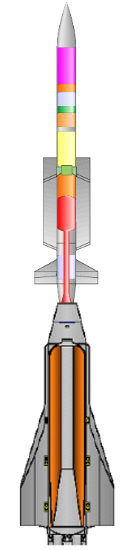
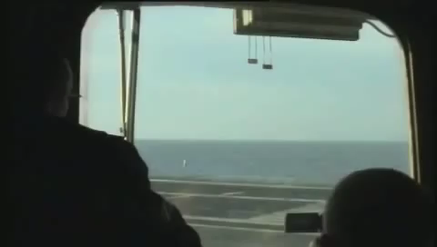
Aeroelasticity Modelling ASTER-30 Characteristics
Accelerometer
+
Gyrometer
Fins
Thrust Vectoring
Booster
Dart
2.2 m
310 kg
2.7 m
140 kg

Slide 5
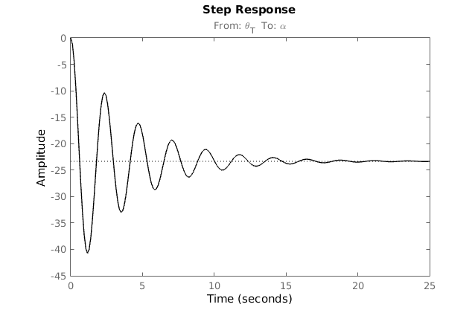
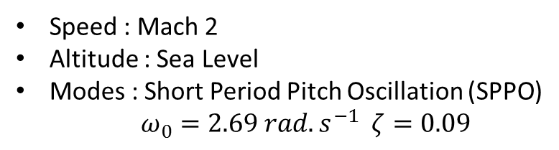

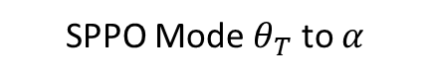




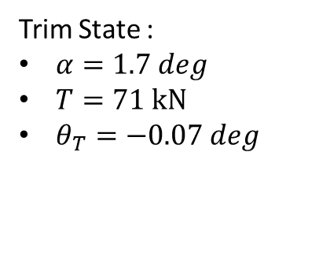
Aeroelasticity Modelling Flight Dynamics
Speed : Mach 2
Altitude : Sea Level
Modes : Short Period Pitch Oscillation (SPPO)
$ω_{0}=2.69 rad.s^{−1}$ $ζ=0.09$
Lift
$$α$$
$$θ$$
2.3s
$$\vec{V}$$
$$γ$$
Drag
Weight
Trim State :
$α=1.7 deg$
$T=71 kN$
$θ_{T}=−0.07 deg$
$$θ_{T}$$
Thrust
SPPO Mode $θ_{T}$ to $α$

Slide 6
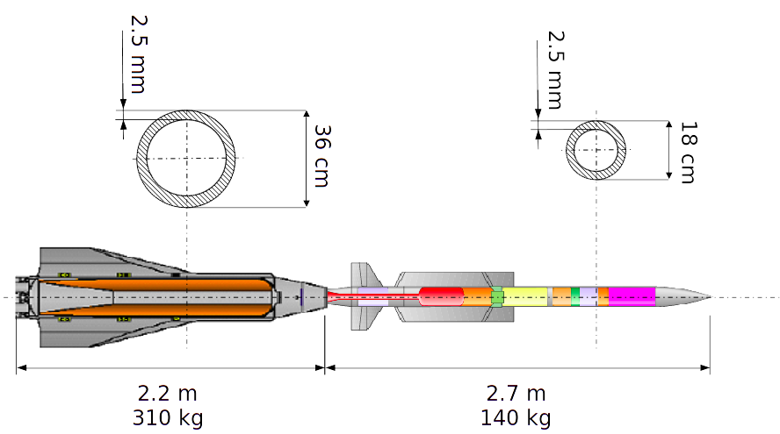
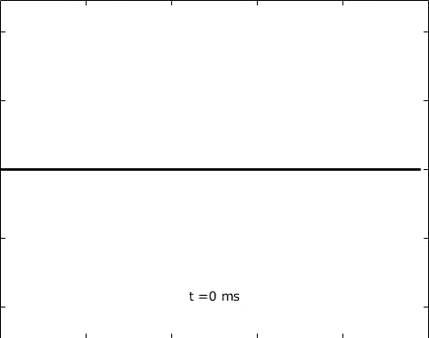

Aeroelasticity Modelling Bending Dynamics
Tail impact
Middle impact
Massless beam element
Point mass

Slide 7
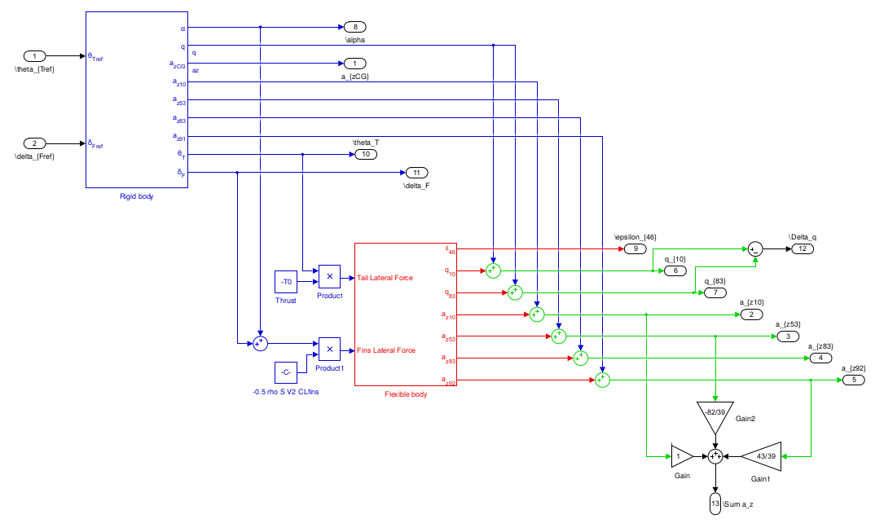
Aeroelasticity Modelling Aeroelasticity Interactions
Legend :
Flight Dynamics
Structural Model
Aeroelasticity

Slide 8
Control Architectures
Lateral Acceleration Control
Notch FIltering
Sensors Placement
Bending Active Damping

Slide 9
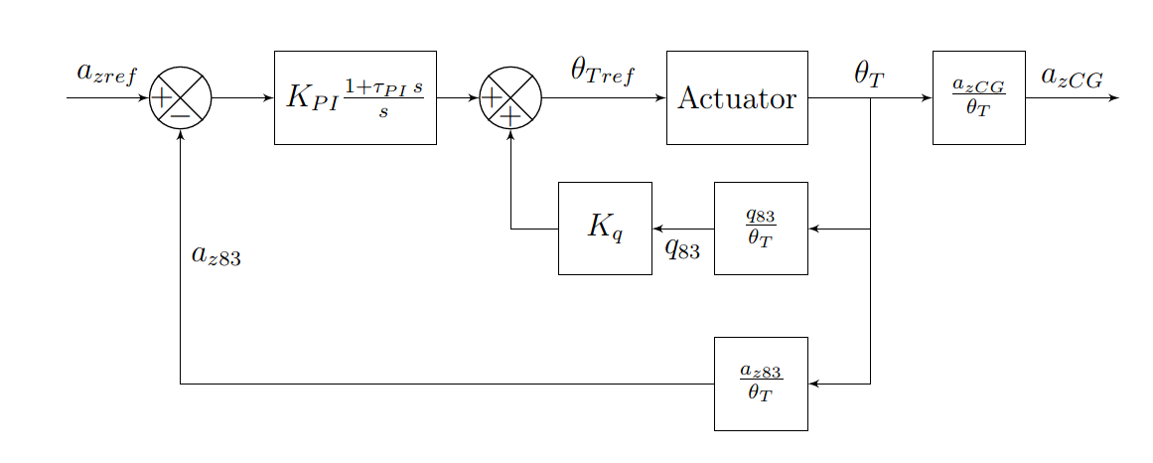
Control Architectures Lateral Acceleration Control
Flexible Missile
PI Controller
Latax Control
Pitch Rate Feedback
SPPO Damping

Slide 10
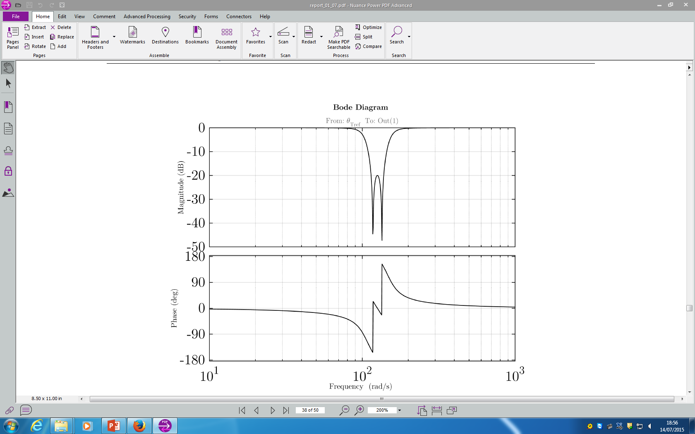
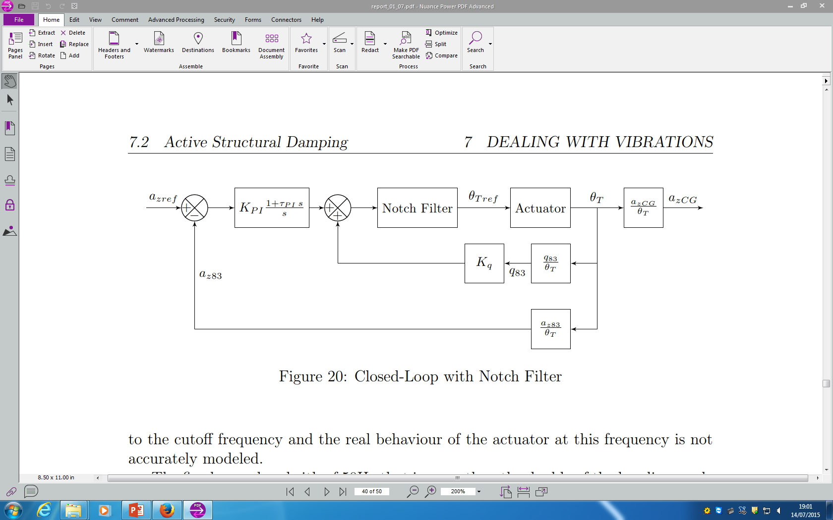
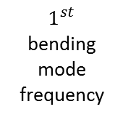
Control Architectures Notch Filtering
$1^{st}$ bending mode frequency
Flexible Missile
Notch Filter Bode Diagram

Slide 11
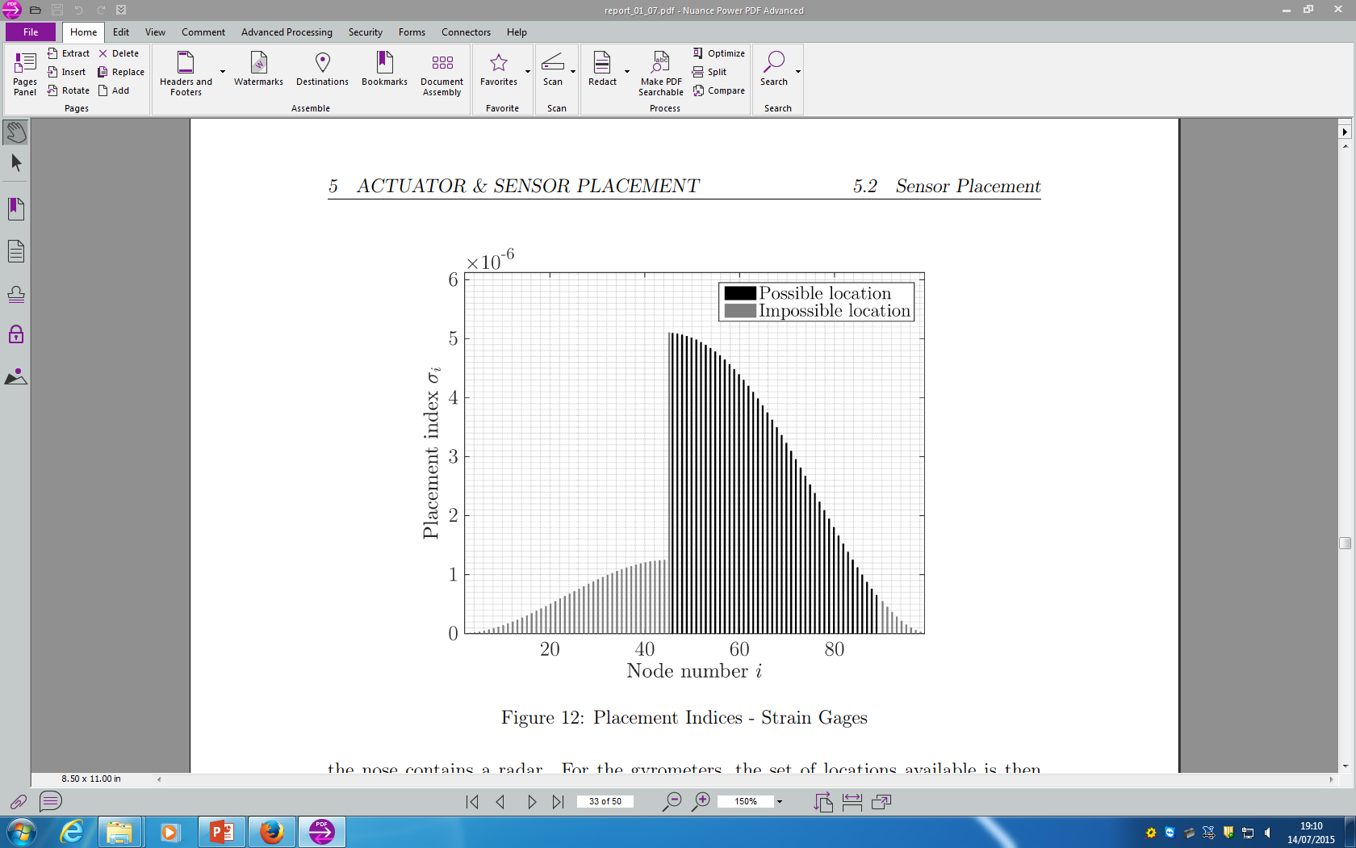
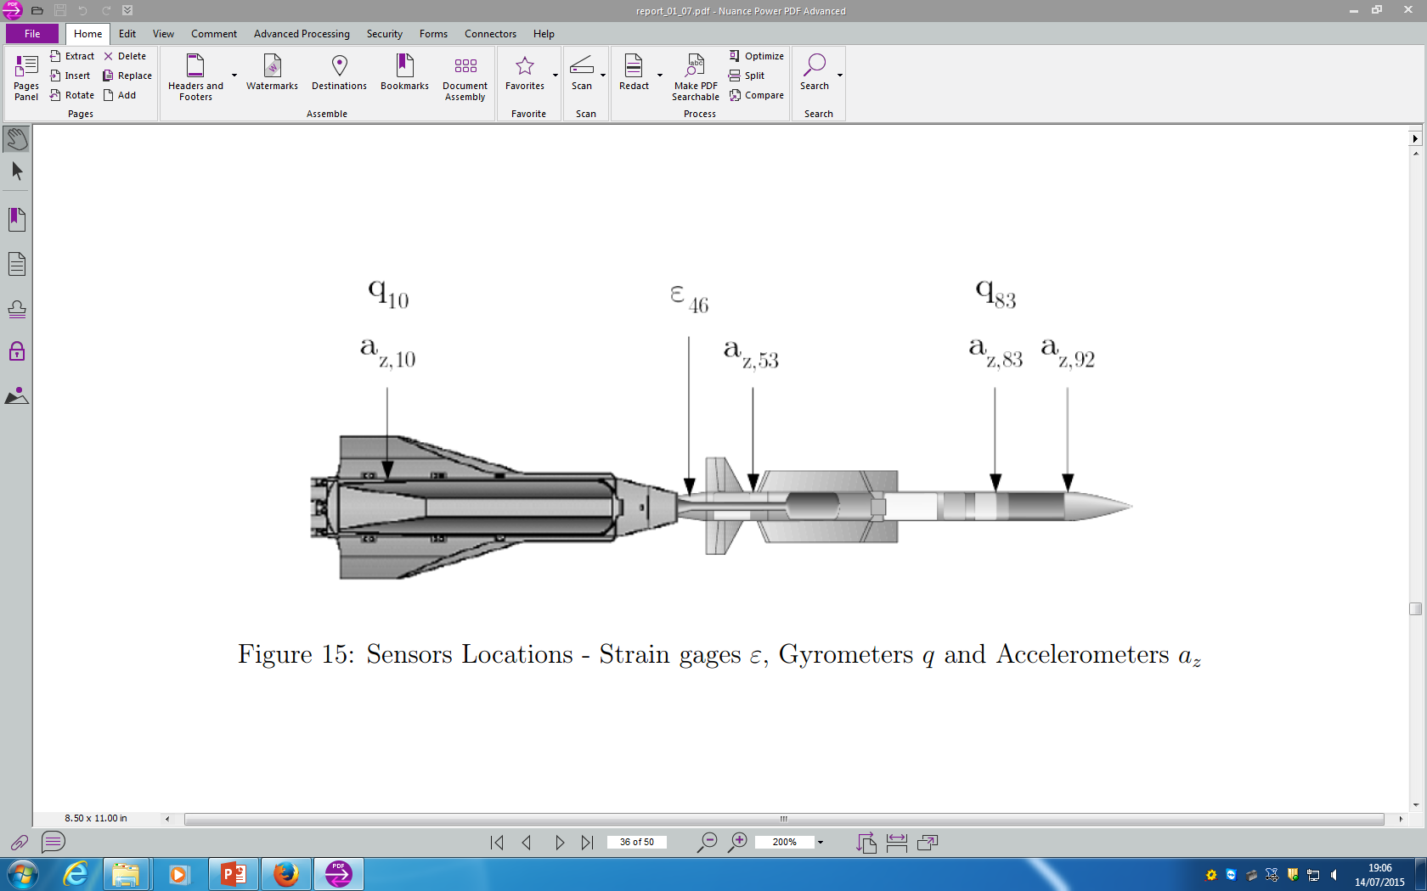
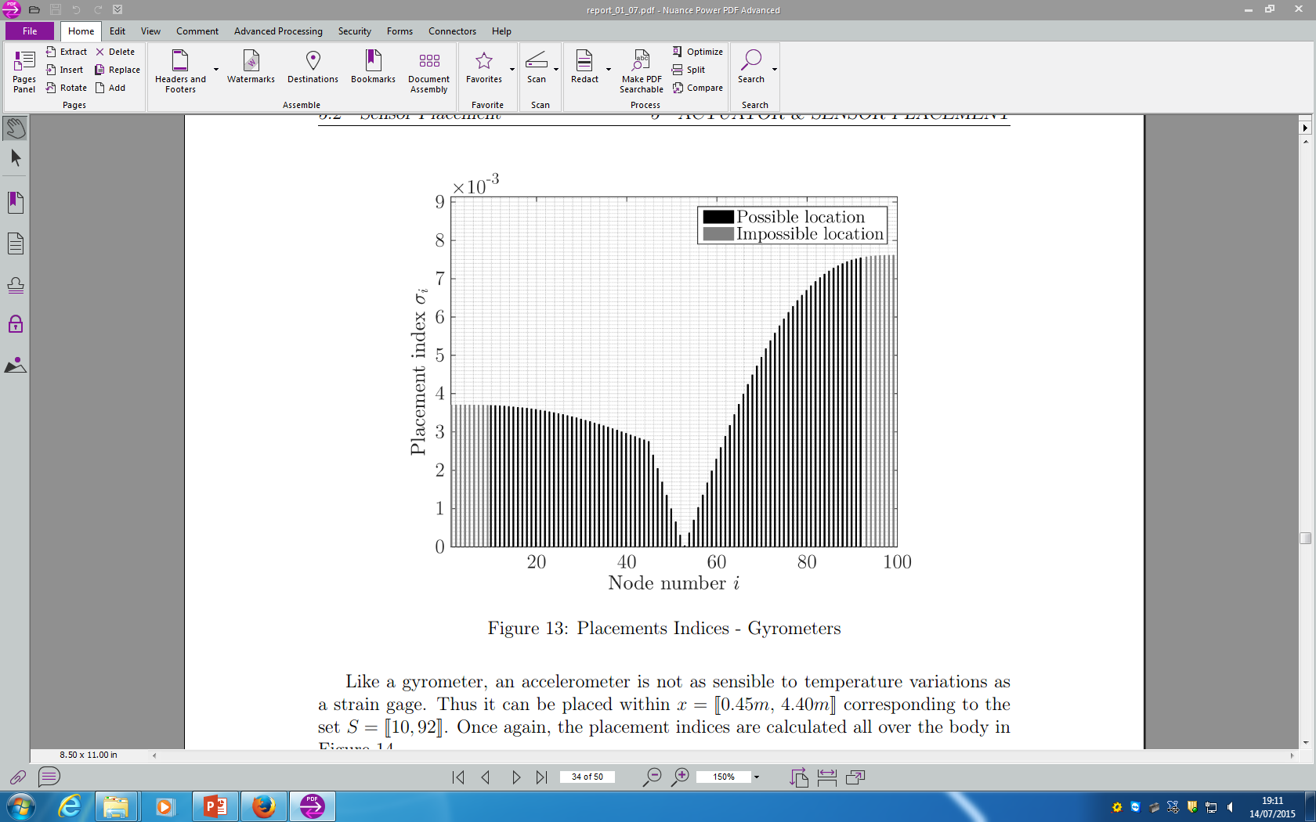
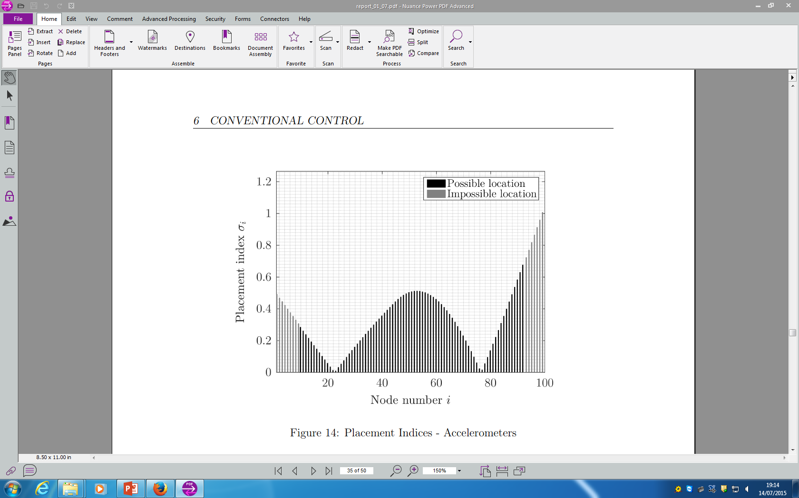

Control Architectures Sensors Placement
Strain Gages
Sensors Locations
Gyrometers
$$ε=strain gage$$
$$q= gyrometer$$
$$a_{z}=accelerometer$$
Accelerometers

Slide 12
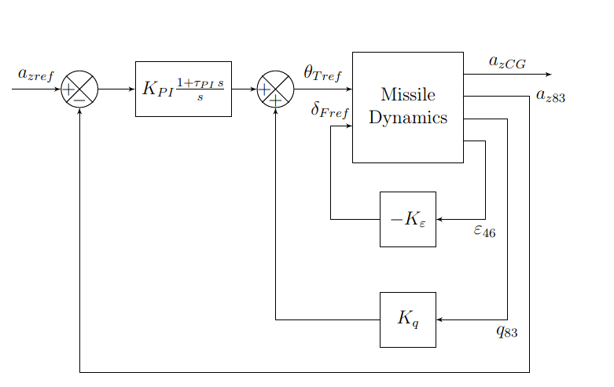
Control Architectures Bending Active Damping
Strain Feedback
Active Damping Using :
Strain gage measurement
Fins deflection

Slide 13
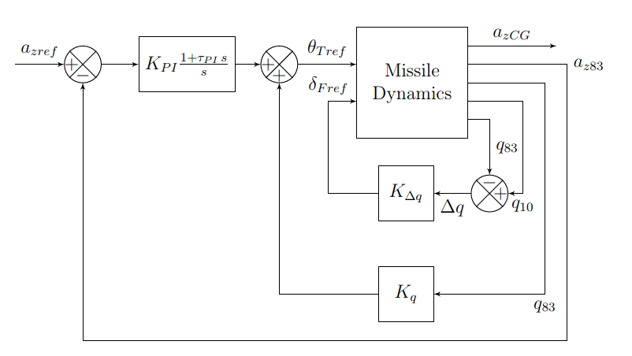
Control Architectures Bending Active Damping
Gyrometers Feedback
Active Damping Using :
Front and rear gyrometers
Fins deflection

Slide 14
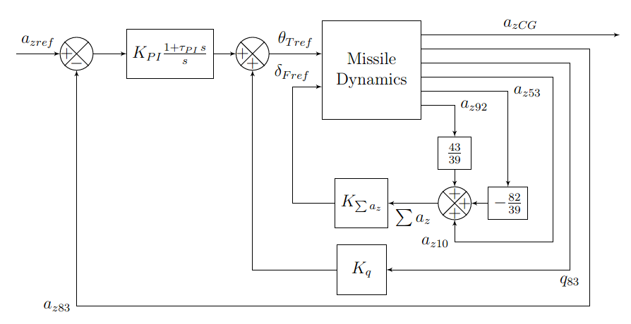
Control Architectures Bending Active Damping
Accelerometers Feedback
Active Damping Using :
Front, middle and rear accelerometers
Fins deflection

Slide 15
Further Studies
Optimal Control
Structural Modifications

Slide 16
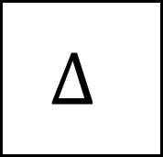
Further Study Optimal Control
$$Δ$$
Structured / Unstructured
Uncertainty Modelling
Noise and Perturbations
Flexible
Missile
K

Slide 17
Further Study Structural Modifications
Static margin
SPPO speed
Minimum diameter
Bending oscillations
frequency
AC
CG

Slide 18
Thank you

